Slide 1
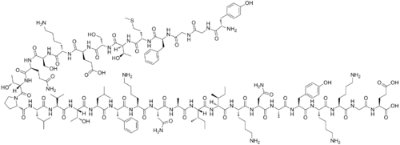
Endogenous Opioids: A Link Between Depression and Impulsivity?
Jazmine Yaeger

Slide 2
What is decision-making?
Understandable concept
…but not easily explained
Consider components….

Slide 3
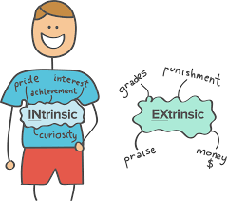
Components of Decision-Making
1. Motivation

Slide 4
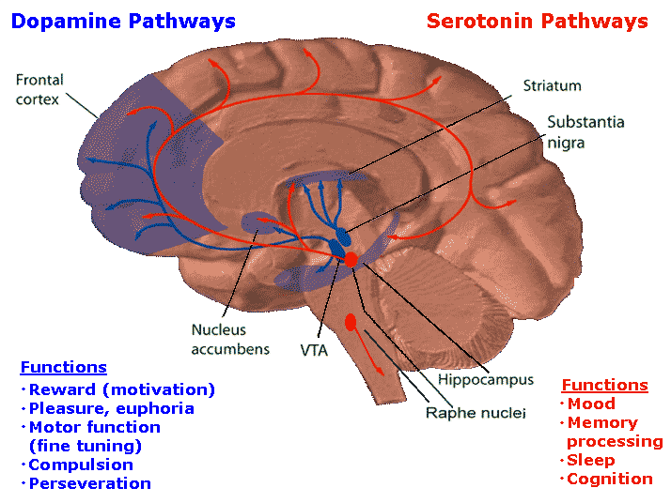
Components of Decision-Making
1. Motivation
-Involves Reward Circuitry

Slide 5
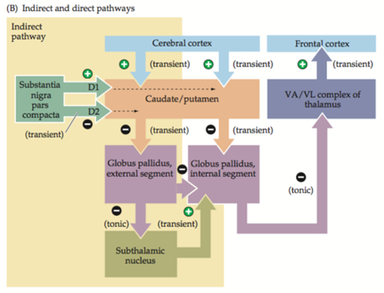
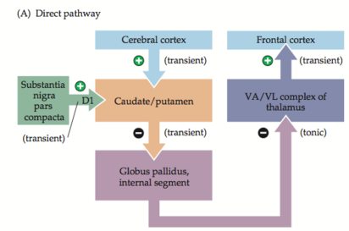
Components of Decision-Making
1. Motivation
-Involves Reward Circuitry
VTA
NAc
VTA = Ventral Tegmental Area; NAc = Nucleus Accumbens

Slide 6
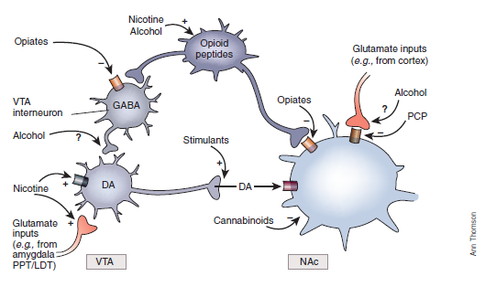
Components of Decision-Making
1. Motivation
-Involves Reward Circuitry
-Influenced by drugs
VTA
NAc
VTA = Ventral Tegmental Area; NAc = Nucleus Accumbens

Slide 7
Components of Decision-Making
2. Choice

Slide 8
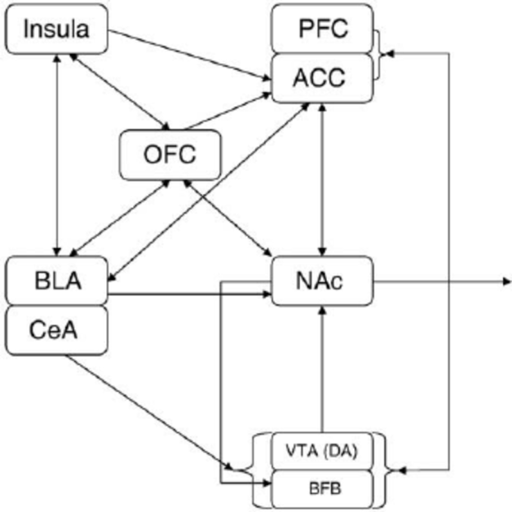
Components of Decision-Making
2. Choice
-Complicated → Not completely understood
-Involves memory
-Goal-directed incentives require communication between the BLA and the IC (Parkes & Balleine, 2013)
BLA = Basolateral Amygdala; IC = Insular Cortex

Slide 9
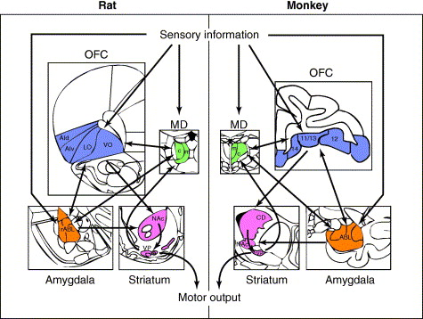
Components of Decision-Making
2. Choice
-Complicated → Not completely understood
-Involves memory
-Preference requires input from the BLA and OFC (Winstanley et al., 2004)
BLA = Basolateral Amygdala; OFC = Orbitofrontal Cortex

Slide 10
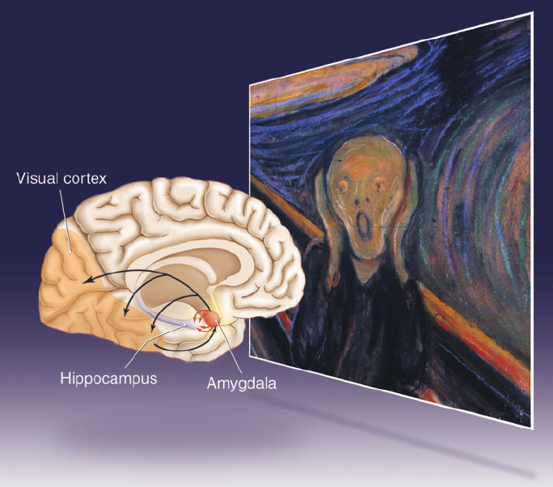
Components of Decision-Making
2. Choice
-Complicated → Not completely understood
-Involves memory
-Emotional memory input also has contributions from the amygdala (Naqvi et al., 2006)

Slide 11
Components of Decision-Making
3. Action
- Involves the motor pathway
-Look familiar?

Slide 12
Components of Decision-Making (In a Practical Sense)
Motivation
Choice
ACTION
or
or
Memory
or

Slide 13
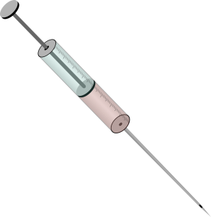
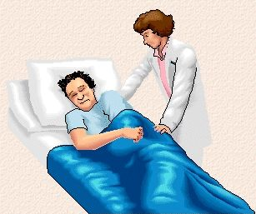
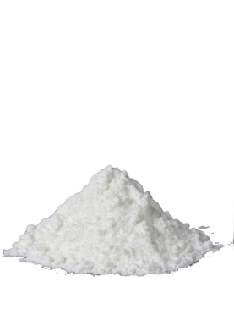
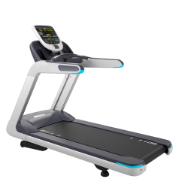
Components of Decision-Making (In a Practical Sense)
Motivation
Choice
ACTION
or
or
Memory
or

Slide 14
But what about depression?
How does it relate to decision-making?

Slide 15
Depression and Decision-Making
Research seems a bit divided…
Anhedonia may be a result of less reward-driven motivation (Treadway et al., 2012)
Impulsivity appears linked to feelings of hopelessness (Swann et al., 2008)
Depressed individuals are more indecisive about career paths (Walker III & Peterson, 2012)
Impulsive behaviors are more common in suicide attempters (Corruble et al., 1999)
…and in gamblers with depression (Haw, 2009)
…and in overeaters with depression (Davis et al., 2004)
…and in drug addicts (Giordano et al., 2002)

Slide 16
Depression and Decision-Making (In a Practical Sense)
Motivation
Choice
ACTION

Slide 17
Depression and Decision-Making (In a Practical Sense)
Motivation
Choice
ACTION
or

Slide 18
Depression and Decision-Making
…But what is the neural mechanism that links depression to decision-making?

Slide 19
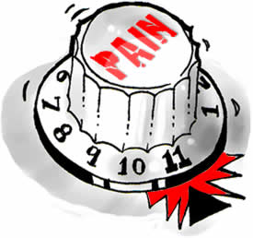
A Role for Endogenous Opioids?
Endogenous Opioids
Neural peptides
Important for many behavior-related functions:
Motivation
Emotion
Pain/Stress
Food intake
Opioids are used as drugs
Morphine – pain
Oxycodone
Methadone
Many others…
Heroin – illegally used for feelings of euphoria
Addictive

Slide 20
A Role for Endogenous Opioids?
Endorphin
Hypothalamus, Brainstem, and Immune Cells
POMC Cells
Enkephalin
Widely Distributed in CNS and Immune Cells
POMC Cells
Dynorphin
Widely Distributed in CNS (particularly in Hypothalamus)
In OT and AVP Cells
Endomorphin
Nucleus of Solitary Tract and Hypothalamus
Histaminergic Cells
POMC = Pro-opiomelanocortin
CNS = Central Nervous System
OT = Oxytocin; AVP = Vasopressin

Slide 21
A Role for Endogenous Opioids?
Receptors:
μ-Opioid Receptor
δ-Opioid Receptor
Κ-Opioid Receptor
Endorphin
Enkephalin
Dynorphin
Endomorphin
All receptors are inhibitory (G_{i})
-However, μ has been found to be excitatory (G_{s}) sometimes in regions of the BNST (Dalsass & Siegel, 1990; Casada & Dafny, 1993) -(This idea might be important later on…)
BNST = Bed Nucleus of the Stria Terminalis

Slide 22
Breaking It Down…
An influence of opioids on decision-making
- Are opioids and decision-making related?
An influence of opioids on depression - Are opioids and depression related?
Bringing everything together
- What is the connection between opioids, decision-making, and depression?

Slide 23
1. An influence of opioids on decision-making
Effects of morphine and naltrexone on impulsive decision making in rats
Kieres, A. K., Hausknecht, K. A., Farrar, A. M., Acheson, A., de Wit, H., & Richards, J. B.

Slide 24
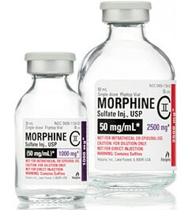
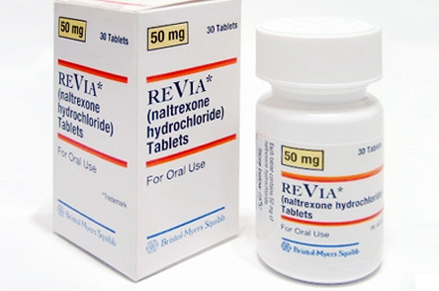
Things to know…
Morphine
Agonist of μ-Opioid Receptors
Naltrexone
Non-specific Opioid Receptor Antagonist
Impulsive
Seeking immediate reward over larger delayed reward
Delay Discounting
Decline in the present value of a reward with delay to its receipt

Slide 25
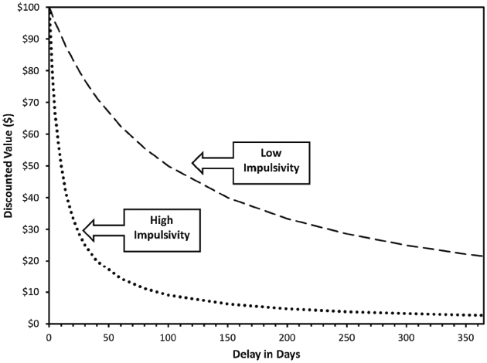
Things to know…
Delay Discounting

Slide 26
Goals:
How does morphine affect impulsivity in rats?
How does naltrexone affect impulsivity in rats?
Can naltrexone reverse the impulsivity changes evoked by morphine?
?
?
?
+

Slide 27
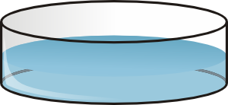
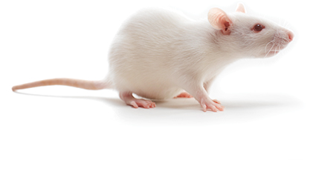
Methods Overview (Simplified)
For 23 hours before testing

Slide 28
Methods Overview (Simplified)
TEST DAY
Tone Generator
Stimulus Lights
Feeder Hole 1
Snout Poke Hole
Feeder Hole 2

Slide 29
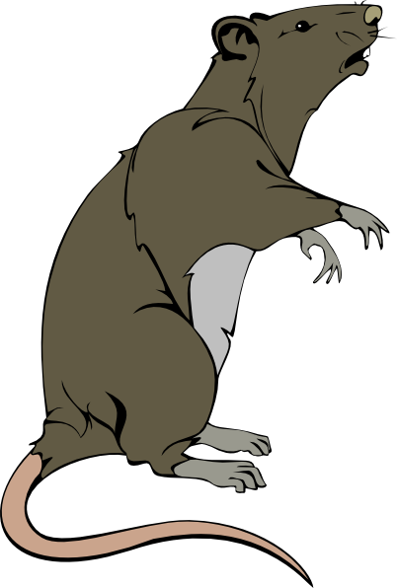
Methods Overview (Simplified)
TEST DAY
Signal Start of Session
Nose Poke Signals Trial Initiation

Slide 30
Methods Overview (Simplified)
Trial Initiated
Signal Choice
4 sec delay
Standard Alternative
150 μl of sucrose solution

Slide 31
Methods Overview (Simplified)
Trial Initiated
Signal Choice
ANIMAL IS REWARDED WITH MORE FOR CHOOSING THE SIDE THAT MAKES THEM WAIT
Choosing this side results in a 15% increase during the next trial
Adjusted Alternative
Choosing this side results in a 15% decrease during the next trial
Immediate adjusted amount of sucrose solution

Slide 32
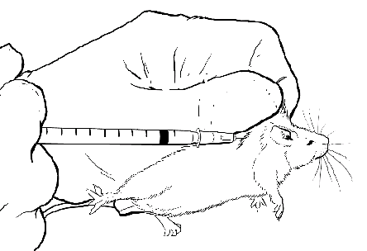
Methods Overview (Simplified)
Trial Initiated
1) Morphine (M)
2) Naltrexone (N)
3) Saline (S)
?
4) S/S
5) N/S
6) S/M
7) N/M

Slide 33
Methods Overview (Simplified)
What does it mean?
Valuing the delayed reward less is indicative of more impulsivity

Slide 34
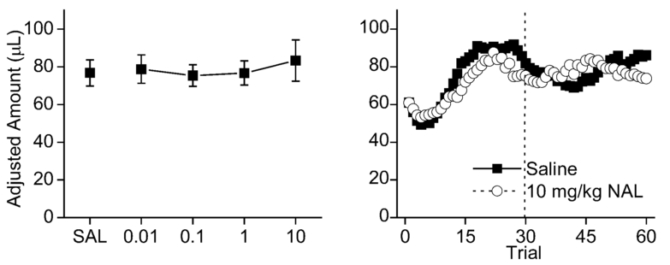
Results
Naltrexone Treatment:
Dose (mg/kg)
Naltrexone did not affect how rats valued the delayed larger reward

Slide 35
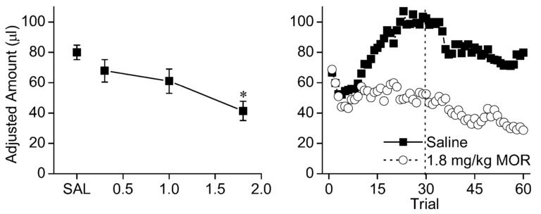
Results
Morphine Treatment:
P < 0.001
Dose (mg/kg)
Morphine appeared to ↓ the value of delayed larger rewards in rats

Slide 36
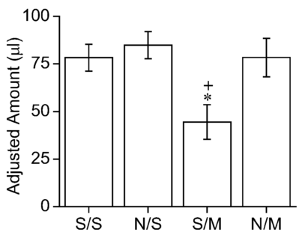
Results
Co-Administration Treatment:
P < 0.05
P < 0.05
Naltrexone reversed the effects of morphine, increasing delayed reward value

Slide 37
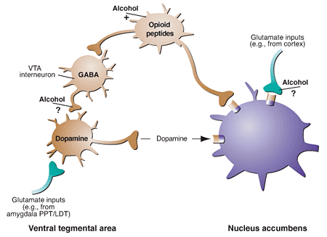
Results/Discussion
Morphine ↓ indifference points
More impulsive
Decrease value of reinforcer?
But morphine is thought to increase reward value
morphine
More Reward

Slide 38
Results/Discussion
Morphine altered perception of time?
Delay is longer for morphine group

Slide 39
Results/Discussion
Morphine interferes with working memory?
Like DA antagonists (Sawaguchi, 2000)
And alcohol (de Oliveira and Nakamura-Palacios, 2003)

Slide 40
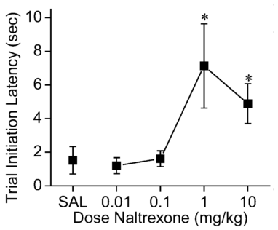
Results
Naltrexone Treatment:
P < 0.001
P < 0.001
Naltrexone ↑ the time it took rats to start trial sessions

Slide 41
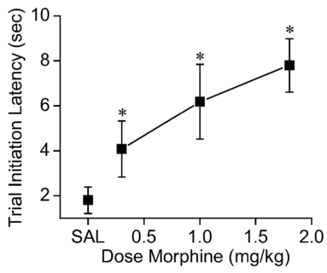
Results
Morphine Treatment:
P < 0.001
P < 0.001
P < 0.001
Morphine ↑ the time it took rats to start trial sessions

Slide 42
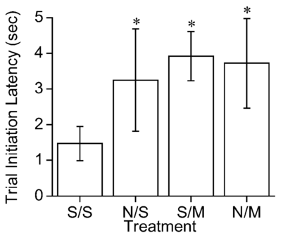
Results
Co-Administration Treatment:
P < 0.05
P < 0.05
P < 0.05
Naltrexone had no effect with morphine on the time to start trials

Slide 43
Results/Discussion
Morphine reduces motivation?
Naltrexone suppresses motivation for food/drink?
Non-specific performance impairment?

Slide 44
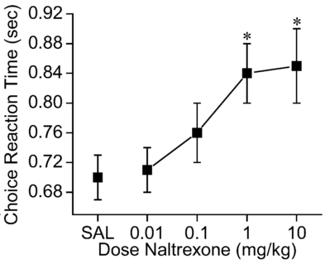
Results
Naltrexone Treatment:
P < 0.001
P < 0.001
Naltrexone ↑ the time it took rats to choose between rewards

Slide 45
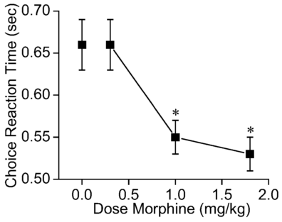
Results
Morphine Treatment:
P < 0.001
P < 0.001
Morphine ↓ the time it took rats to choose between rewards

Slide 46
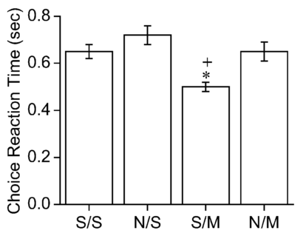
Results
Co-Administration Treatment:
P < 0.05
P < 0.05
Naltrexone reversed the effects of morphine, increasing the choice latency

Slide 47
Results/Discussion
Morphine decreases decision time
Characteristic of impulsivity

Slide 48
How does this fit our goal?
1. An influence of opioids on decision-making
Morphine influences decision-making
Morphine is a strong μ-opioid receptor agonist
Endogenous opioids likely have a similar (but perhaps less dramatic) influence on decision-making

Slide 49
How does this fit our goal?
Motivation
Choice
ACTION
or
Memory

Slide 50
…But what about depression?

Slide 51
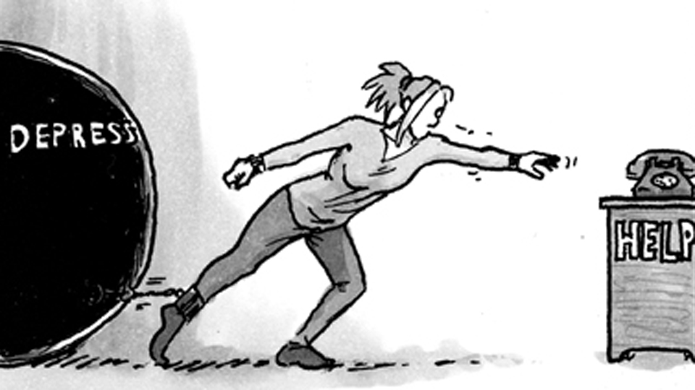
2. An influence of opioids on depression
A role for the mu opioid receptor in the antidepressant effects of buprenorphine
Robinson, S. A., Erickson, R. L., Browne, C. A., & Lucki, I.

Slide 52
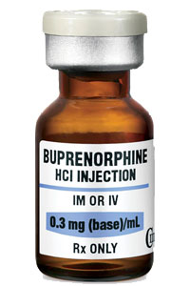
Things to know…
↑ Stress → ↑ Dynorphin → ↑Dysphoria and Depression
Remember: Dynorphin works at Κ-opioid receptors
Buprenorphine (BPN)
Alleviates depression
Suppressing suicidal thoughts
Thought to be Κ-opioid receptor (KOR) antagonist
And a µ-opioid receptor (MOR) agonist
Work at KOR for antidepressant effects?

Slide 53
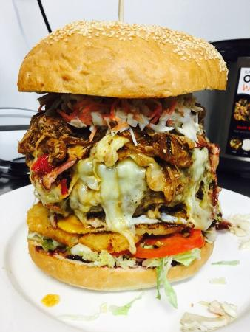
Goals:
What is the precise pharmacodynamic action of BPN?
How does BPN induce behavioral responses?
?
KOR
?
MOR
KOR ?
?
MOR ?
+

Slide 54
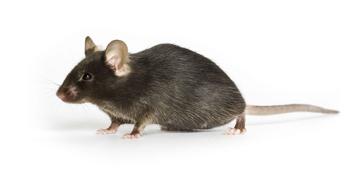
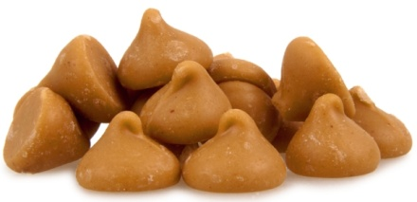
Methods Overview (Simplified)
Novelty-Induced Hypophagia (NIH) Test:
Training Day
1 Hour
Requirements for Experimental Participation:
Food consumed in 15 min session
Approach food in 30 sec or less for 3 days
C57BL/6J
Oprm⁻/₋
Oprk⁻/₋
Mouse Home Cage

Slide 55
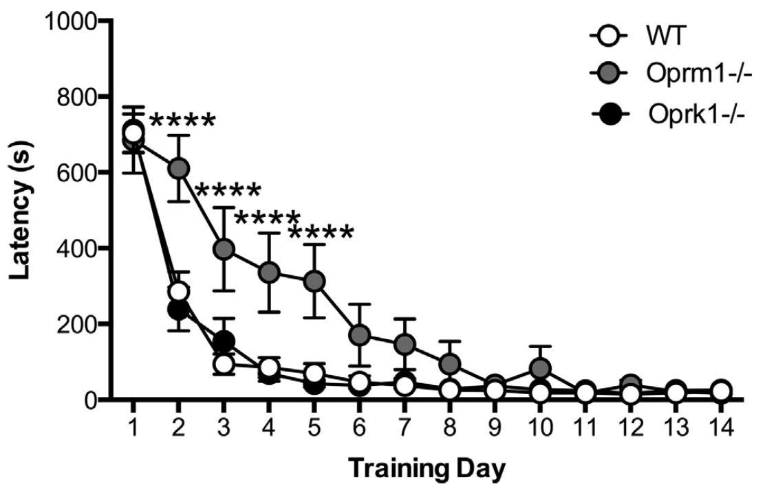
Results from Training Day
P < 0.0001
P < 0.0001
Oprm⁻/₋ mice expressed higher latencies to approach food
Impaired Learning?
Less Value of Food?

Slide 56
Methods Overview (Simplified)
Novelty-Induced Hypophagia (NIH) Test:
Experimental Day
Latency to approach food is measured
Novel Cage

Slide 57
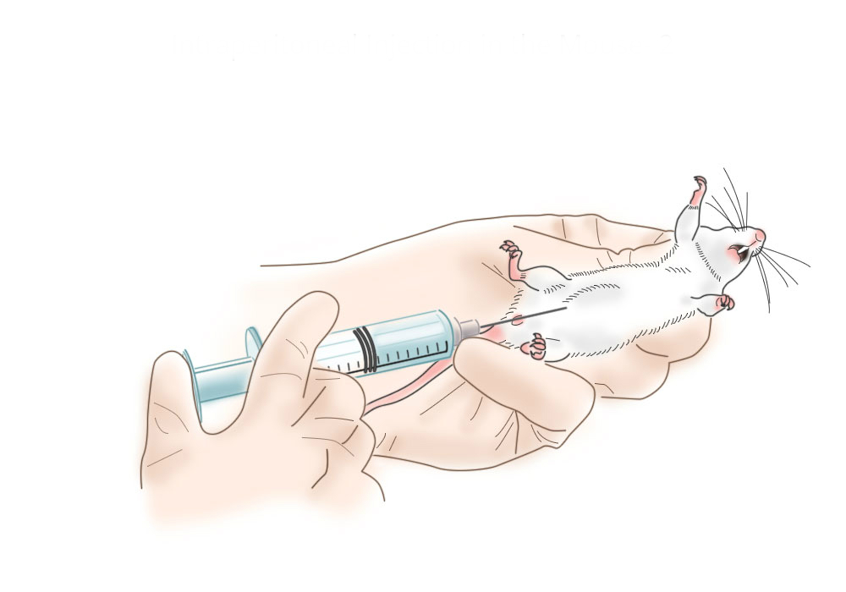
Methods Overview (Simplified)
Novelty-Induced Hypophagia (NIH) Test:
Experiment 1
Latency to approach food is measured
24 Hours
Vehicle
BPN
Novel Cage

Slide 58
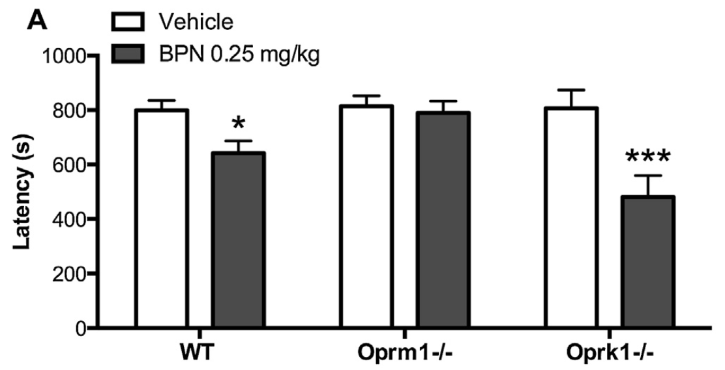
Results from Experiment 1
P < 0.05
P < 0.001
Oprm⁻/₋ mice did not adjust approach latency with BPN treatment

Slide 59
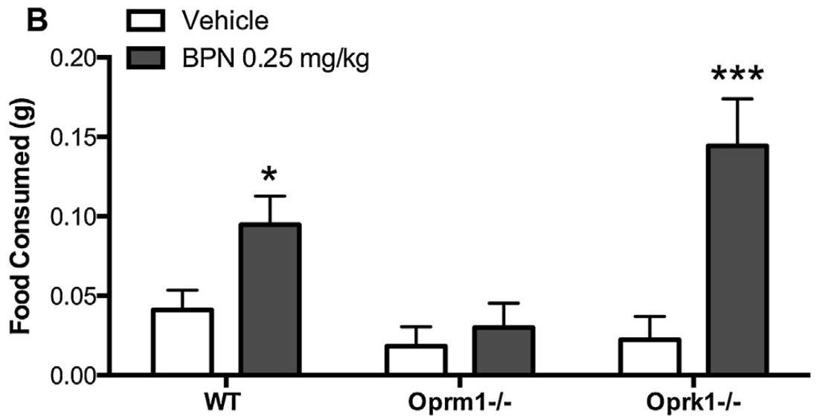
Results from Experiment 1
P < 0.001
P < 0.05
Oprm⁻/₋ mice did not adjust food intake with BPN treatment

Slide 60
Results from Experiment 1
μ-Opioid Receptors Must be Important for the Pharmacological effects of BPN

Slide 61
Methods Overview (Simplified)
Novelty-Induced Hypophagia (NIH) Test:
Experiment 2
Latency to approach food is measured
24 Hours
Vehicle
Morphine (MOR agonist)
Nor-BNI (KOR antagonist)
Novel Cage

Slide 62
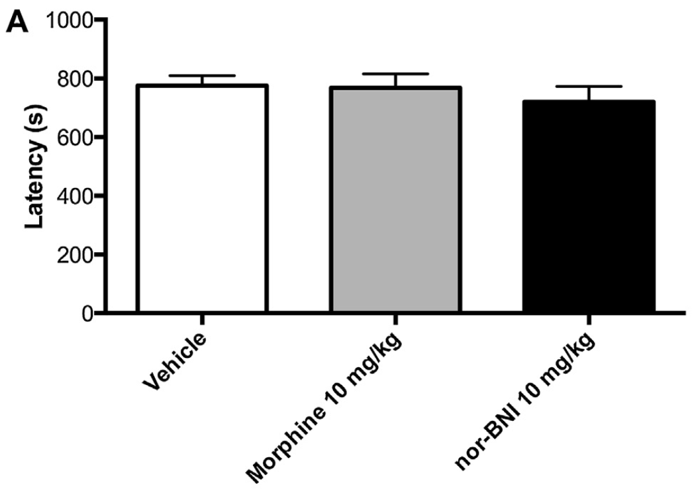
Results from Experiment 2
Morphine and nor-BNI had no effect on latency to approach food

Slide 63
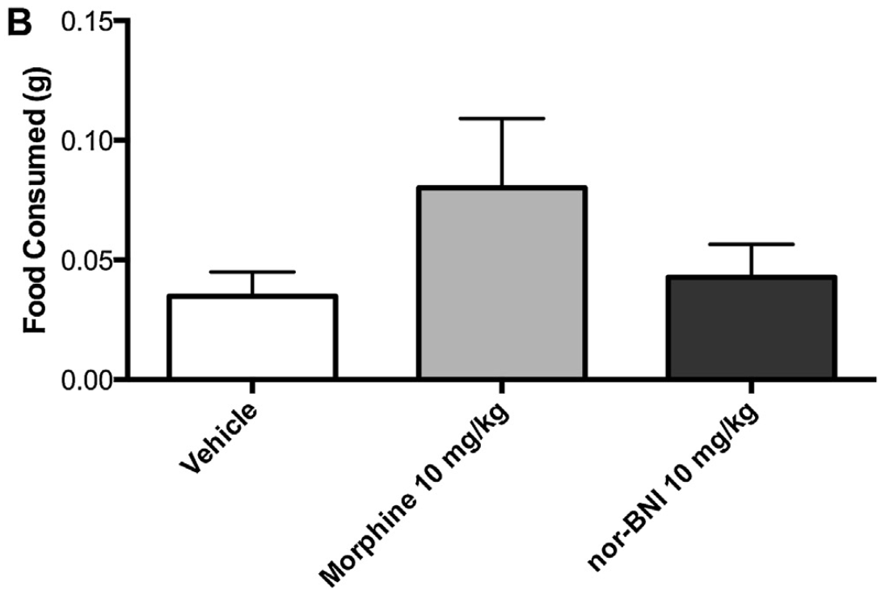
Results from Experiment 2
Morphine and nor-BNI had no effect on the amount of food consumed

Slide 64
Results from Experiment 2
Κ-Opioid Receptors are Less Important for the Pharmacological Effects of BPN

Slide 65
Methods Overview (Simplified)
Novelty-Induced Hypophagia (NIH) Test:
Experiment 3
Latency to approach food is measured
1 Hour
&
24 Hours
Vehicle
Cyprodime (MOR antagonist)
Novel Cage

Slide 66
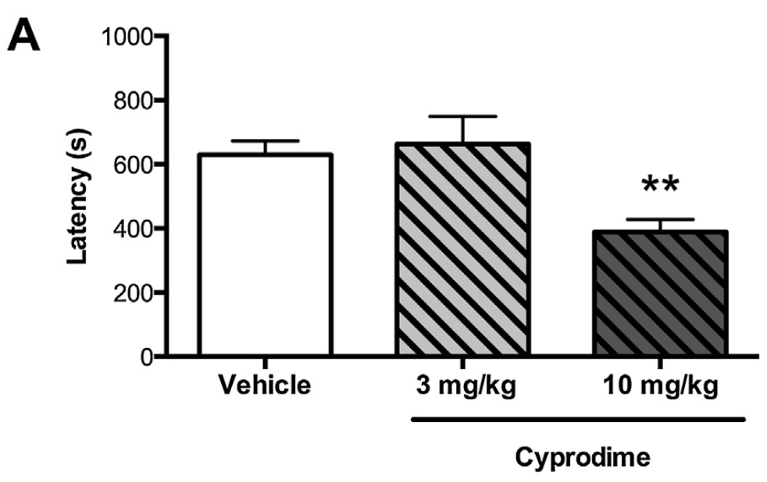
Results from Experiment 3
1 Hour Post-Administration
P < 0.01
Cyprodime at higher dose decreases latency to approach food

Slide 67
Results from Experiment 3
24 Hour Post-Administration
Cyprodime had no effect on latency to approach food

Slide 68
Results from Experiment 3
1 Hour Post-Administration
P < 0.05
Cyprodime at higher dose increases food consumed

Slide 69
Results from Experiment 3
24 Hour Post-Administration
Cyprodime had no effect on food consumed

Slide 70
Results from Experiment 3
μ-Opioid Receptors Antagonism Shows Similar Results in the NIH Test to BPN
(Cyprodime’s effects appear to be short-lasting, however)

Slide 71
Methods Overview (Simplified)
Novelty-Induced Hypophagia (NIH) Test:
Experiment 4
Latency to approach food is measured
1 Hour
&
24 Hours
Vehicle
Naltrexone
Novel Cage

Slide 72
Results from Experiment 4
1 Hour Post-Administration
P < 0.05
Naltrexone decreases latency to approach food

Slide 73
Results from Experiment 4
24 Hour Post-Administration
Naltrexone had no effect on latency to approach food

Slide 74
Results from Experiment 4
1 Hour Post-Administration
Naltrexone had no effect on food consumed

Slide 75
Results from Experiment 3
24 Hour Post-Administration
Naltrexone had no effect on food consumed

Slide 76
Sorting it all out…(Discussion)
1) BPN’s pharmacological activity is on MOR
(How we know: Oprm⁻/₋ mice did not undergo behavioral changes with treatment)
2) BPN acts as an MOR ANTAGONIST
(How we know: Cyprodime [and somewhat Naltrexone] had effects similar to BPN…Also, KOR manipulation had no effect on behavior)
MOR
MOR

Slide 77
But…huh?
I thought…
The MOR agonist morphine ↑ impulsivity?
And MOR is inhibitory (G_{i})?
Morphine
More Reward
& Less Depression?

Slide 78
But…huh?
But…
Stress-driven activation of MOR in VTA can ↓ DA in the NAc (Latagliata et al., 2014)
In this instance, MOR antagonism would produce hedonic effects
The amygdala is most likely involved (Wilson & Junor, 2008)
Morphine
STRESS
Depression?

Slide 79
How does this fit our goal?
2. An influence of opioids on depression
BPN minimizes depression symptoms
BPN antagonizes μ-opioid receptors
Endogenous opioids are likely involved in mediating the onset and extinction of depressive behaviors

Slide 80
How does this fit our goal?
Motivation
Choice
ACTION
or
STRESS

Slide 81
But what mechanism determines endogenous opioid contribution?
How is the system regulated?

Slide 82
3. Bringing everything together
Orexin signaling in the VTA gates morphine-induced synaptic plasticity
Baimel, C. & Borgland, S. L.

Slide 83
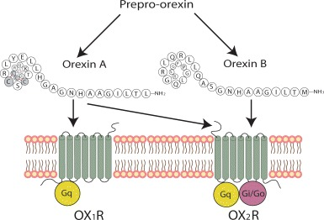
Things to know…
Orexin is a Peptide Neurohormone
2 Types From Single Precursor Protein
Orexin A (Hypocretin 1) → 33 aa
Binds Orx₁ & Orx₂ receptors with approximately equal affinity
Orexin B (Hypocretin 2) → 28 aa
Binds Orx₂ receptor more readily

Slide 84
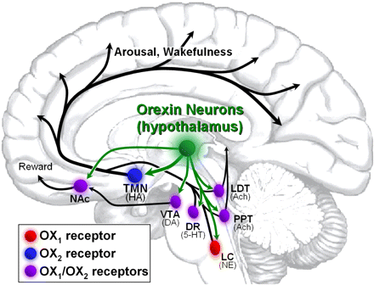
Things to know…
Orexin has far-reaching influences on brain activity/behavior
Note: Projections to the VTA and NAc

Slide 85
Things to know…
Orexin is important in regulating:
Arousal/Wakefulness
Appetite
Anxiety

Slide 86
Things to know…
Synaptic Plasticity
A change in synapse arrangement that leads to a stronger or weaker neuronal signaling
Long-Term Potentiation (LTP)
A change in synaptic organization that leads to a stronger signal
Commonly involves activation of NMDA channels and trafficking of AMPA receptors

Slide 87
Goals:
How is synaptic plasticity induced in the VTA?
Is there a relationship between orexin, opioids, and synaptic rearrangement in the VTA?
?
?
?
?
+
+

Slide 88
Methods Overview (Simplified)
Systemic Procedure
15 Minutes
24 Hours
Drug Treatment 1
SB 334867 (Orx1R Antagonist)
Vehicle
No Treatment
Drug Treatment 2
Morphine
Saline

Slide 89
Results
A way of labeling specific neurons
DA-specific cells are labeled
Notes:
Fig. 5 A-C

Slide 90
Results
P < 0.01
P < 0.05
#cells/#rats
Blocking (nonspecifically) Orx1R prevents AMPA membrane insertion induced by morphine administration

Slide 91
Results
P < 0.01
P < 0.05

Slide 92
Results
P < 0.01
P < 0.01
Blocking (nonspecifically) Orx1R prevents presynaptic excitatory release induced by morphine administration

Slide 93
Results
P < 0.05
P < 0.05
Blocking (nonspecifically) Orx1R prevents postsynaptic (AMPA) response induced by morphine administration

Slide 94
Results
P < 0.05
P < 0.05
Blocking (nonspecifically) Orx1R prevents excitatory postsynaptic response induced by morphine

Slide 95
Results
P < 0.05
P < 0.05
Blocking (nonspecifically) Orx1R reverses presynaptic GABA inhibition induced by morphine administration

Slide 96
Results
Morphine and the blockade (nonspecifically) of Orx1R have no effect on postsynaptic inhibitory signaling

Slide 97
Results/Discussion
Systemic Morphine → ↑ Potentiation at Excitatory Synapses onto VTA DA neurons
Systemic Morphine → ↓ Probability of Presynaptic GABA release onto VTA DA neurons
Systemic Orexin → Reverses Morphine-Promoted Effects at Excitatory and Inhibitory Synapses onto VTA DA neurons

Slide 98
Results
P < 0.001
P < 0.05
SYSTEMIC
Blocking (nonspecifically) Orx1R reverses the excitatory/inhibitory shift induced by morphine administration
Notes:
Fig. 5 A-C

Slide 99
Results/Discussion
Systemic Orexin → Regulates the Morphine-Driven Shift from Inhibitory to Exitatory Signaling onto VTA DAergic neurons
But…does orexin work directly at the VTA, or is the effect mediated through some other connection?

Slide 100
Methods Overview (Simplified)
Intra-VTA Procedure
Recovery Period
5 Minutes
24 Hours
Drug Treatment 2
Morphine
Saline
Drug Treatment 1
SB 334867
Vehicle

Slide 101
Results
P < 0.001
P < 0.01
P < 0.05
Blocking Orx1R in the VTA prevents AMPA membrane insertion induced by morphine administration
Notes:
Fig. 2 A-B; No block of morphine activity when SB 334867 dose is 10x lower or when put outside of the VTA.

Slide 102
Results
P < 0.001
Blocking Orx1R in the VTA prevents presynaptic excitatory release induced by morphine administration
Notes:
Fig. 2 C-D

Slide 103
Results
P < 0.05
Blocking Orx1R in the VTA prevents postsynaptic (AMPA) response induced by morphine administration
Notes:
Fig. 2 C & E

Slide 104
Results
P < 0.01
Blocking Orx1R in the VTA reverses presynaptic GABA inhibition induced by morphine administration
Notes:
Fig. 4 A-B

Slide 105
Results
Morphine (nonspecifically) and the blockade of Orx1R (in the VTA) have no effect on postsynaptic inhibitory signaling
Notes:
Fig. 4 A & C

Slide 106
Results/Discussion
Systemic Morphine → ↑ Potentiation at Excitatory Synapses onto VTA DA neurons
Systemic Morphine → ↓ Probability of Presynaptic GABA release onto VTA DA neurons
Intra-VTA Orexin → Reverses Morphine-Promoted Effects at Excitatory and Inhibitory Synapses onto VTA DA neurons

Slide 107
Sorting it all out…(Discussion)
Orexin is important for gating opioid-induced synaptic plasticity in VTA neurons
But morphine administration to the lateral hypothalamus (LH) has an inhibitory effect on orexin release (Li and van den Pol, 2008)
Maybe a result of differential µ-opioid receptor activity (G_{i} or G_{s}) in subpopulations of orexin cells
Maybe a result of disinhibition of tonic GABA release onto orexin cells
Orexin is important for gating the probability of GABA release in VTA neurons
Mechanism likely involves endocannabinoid inhibition of GABA release

Slide 108
How does this fit our goal?
3. Bringing everything together
Endogenous opioids, through μ-opioid receptors, play a role in:
Decision Making
Depression
Synaptic Plasticity in the Reward/Motion Pathway
Orexin gates the activity of opioids

Slide 109
How does this fit our goal?
BPN =
μ⁻
-
+
Orx₁
GABA_{Cell}
Orexin A
NE_{Cell} in LC
GABA
Orexin_{Cell} in LH
μ⁻
GABA_{Cell}
Endorphin
μ⁺
-
+
Orx₁
NE
Orexin_{Cell} in LH
Orexin A
DA_{Cell} in VTA
μ⁻
Κ
-
+
-
Dyn
GABA
ANXIETY
2-AG
DA
μ⁻
Cb
GABA_{Cell}
-
NAc
+
Hedonic Response
+
+
-
-
Depression
NIH
+
-
Reinforcement (Motivation)
-
μ⁺ = excitatory mu-opioid receptor; μ⁻ = inhibitory mu-opioid receptor; LH = lateral hypothalamus; Orx₁ = orexin type 1 receptor; DA = dopamine; VTA = ventral tegmental area; NAc = nucleus accumbens; NIH = novelty-induced hypophagia; NE = norepinephrine; LC = locus ceruleus; BPN = buprenorphine ; Dyn = dynorphin; Κ = kappa-opioid receptor; 2-AG = 2-arachidonoylglycerol; Cb = cannabinoid receptor

Slide 110
How does this fit our goal?
Motivation
Choice
ACTION

Slide 111
How does this fit our goal?
BPN =
μ⁻
-
+
Orx₁
GABA_{Cell}
Orexin A
NE_{Cell} in LC
GABA
Orexin_{Cell} in LH
Endorphin
μ⁻
+
Orx₁
NE
Orexin_{Cell} in LH
Orexin A
DA_{Cell} in VTA
Κ
+
-
Dyn
ANXIETY
DA
NAc
+
Hedonic Response
+
+
-
-
Depression
NIH
+
-
Reinforcement (Motivation)
-
μ⁻ = inhibitory mu-opioid receptor; LH = lateral hypothalamus; Orx₁ = orexin type 1 receptor; DA = dopamine; VTA = ventral tegmental area; NAc = nucleus accumbens; NIH = novelty-induced hypophagia; NE = norepinephrine; LC = locus ceruleus; BPN = buprenorphine; Dyn = dynorphin; Κ = kappa-opioid receptor; BPN = buprenorphine

Slide 112
How does this fit our goal?
Motivation
Choice
ACTION
or

Slide 113
How does this fit our goal?
BPN =
μ⁻
-
+
Orx₁
GABA_{Cell}
Orexin A
NE_{Cell} in LC
GABA
Orexin_{Cell} in LH
μ⁻
GABA_{Cell}
Endorphin
μ⁺
-
+
Orx₁
NE
Orexin_{Cell} in LH
Orexin A
DA_{Cell} in VTA
-
+
GABA
ANXIETY
2-AG
DA
μ⁻
Cb
GABA_{Cell}
-
NAc
+
Hedonic Response
+
+
Depression
NIH
+
Reinforcement (Motivation)
μ⁺ = excitatory mu-opioid receptor; μ⁻ = inhibitory mu-opioid receptor; LH = lateral hypothalamus; Orx₁ = orexin type 1 receptor; DA = dopamine; VTA = ventral tegmental area; NAc = nucleus accumbens; NIH = novelty-induced hypophagia; NE = norepinephrine; LC = locus ceruleus; 2-AG = 2-arachidonoylglycerol; Cb = cannabinoid receptor; BPN = buprenorphine

Slide 114
The End Message
Endogenous opioids appear to be involved in decision-making
Likely in the motivation and action components
Endogenous opioids appear to be involved in depressive behaviors
With μ-opioid receptors having a key role
Orexin gates the activity of μ-opioid receptors in the VTA
The exact mechanism is unknown, however

Slide 115
The End Message
Unanswered questions…
To what extent do other endogenous opioids (or other neurohormones) affect depression and decision-making?
Can depressive symptoms be alleviated by targeting the gating mechanism (orexin pathways) rather than opioid receptors?
And more…

Slide 116
References:
Baimel, C., et al. (2015). "Orexin/hypocretin role in reward: implications for opioid and other addictions." British journal of pharmacology 172(2): 334-348.
Baimel, C. and S. L. Borgland (2015). "Orexin signaling in the VTA gates morphine-induced synaptic plasticity." The journal of neuroscience 35(18): 7295-7303.
Balleine, B. W., et al. (2007). "The role of the dorsal striatum in reward and decision-making." The journal of neuroscience 27(31): 8161-8165.
Boksem, M. A. and M. Tops (2008). "Mental fatigue: costs and benefits." Brain research reviews 59(1): 125-139.
Casada, J. and N. Dafny (1993). "Responses of neurons in bed nucleus of the stria terminalis to microiontophoretically applied morphine, norepinephrine and acetylcholine." Neuropharmacology 32(3): 279-284.
Corruble, E., et al. (1999). "Impulsivity: a relevant dimension in depression regarding suicide attempts?" Journal of affective disorders 53(3): 211-215.
Dalsass, M. and A. Siegel (1990). "Opioid peptide regulation of neurons in the bed nucleus of the stria terminalis: a microiontophoretic study." Brain research 531(1–2): 346-349.
Davis, C., et al. (2004). "Decision‐making deficits and overeating: A risk model for obesity." Obesity research 12(6): 929-935.
de Oliveira, R. W. D. and E. M. Nakamura-Palacios (2003). "Haloperidol increases the disruptive effect of alcohol on spatial working memory in rats: a dopaminergic modulation in the medial prefrontal cortex." Psychopharmacology 170(1): 51-61.
Giordano, L. A., et al. (2002). "Mild opioid deprivation increases the degree that opioid-dependent outpatients discount delayed heroin and money." Psychopharmacology 163(2): 174-182.
Gotter, A. L., et al. (2012). "International Union of Basic and Clinical Pharmacology. LXXXVI. Orexin receptor function, nomenclature and pharmacology." Pharmacological reviews 64(3): 389-420.
Gray, J. C. and J. MacKillop (2015). "Impulsive delayed reward discounting as a genetically-influenced target for drug abuse prevention: a critical evaluation." Frontiers in Psychology 6(1104).
Haw, J. (2009). "Impulsivity partially mediates the relationship between depression and problem gambling." Gambling Research 21(2): 12.
Holland, P. and P. J. Goadsby (2007). "The hypothalamic orexinergic system: pain and primary headaches." Headache: The Journal of Head and Face Pain 47(6): 951-962.
Kieres, A. K., et al. (2004). "Effects of morphine and naltrexone on impulsive decision making in rats." Psychopharmacology 173(1-2): 167-174.
Latagliata, E. C., et al. (2014). "Stress-induced activation of ventral tegmental mu-opioid receptors reduces accumbens dopamine tone by enhancing dopamine transmission in the medial pre-frontal cortex." Psychopharmacology 231(21): 4099-4108.
Li, Y. and A. N. van den Pol (2008). "μ-Opioid receptor-mediated depression of the hypothalamic hypocretin/orexin arousal system." Journal of Neuroscience 28(11): 2814-2819.
Luo, Y., et al. (2010). "NMDA receptors on non-dopaminergic neurons in the VTA support cocaine sensitization." PLoS One 5(8): e12141.
Naqvi, N., et al. (2006). "The Role of Emotion in Decision Making." Current Directions in Psychological Science 15(5): 260-264.
Parkes, S. L. and B. W. Balleine (2013). "Incentive memory: evidence the basolateral amygdala encodes and the insular cortex retrieves outcome values to guide choice between goal-directed actions." Journal of Neuroscience 33(20): 8753-8763.
Purves, D., et al. (2012). Neuroscience, Sinauer Associates.
Robinson, S. A., et al. (2017). "A role for the mu opioid receptor in the antidepressant effects of buprenorphine." Behavioural Brain Research 319: 96-103.
Sawaguchi, T. (2001). "The effects of dopamine and its antagonists on directional delay-period activity of prefrontal neurons in monkeys during an oculomotor delayed-response task." Neuroscience research 41(2): 115-128.
Schoenbaum, G., et al. "Orbitofrontal cortex, decision-making and drug addiction." Trends in Neurosciences 29(2): 116-124.
Swann, A. C., et al. (2008). "Impulsivity: differential relationship to depression and mania in bipolar disorder." Journal of affective disorders 106(3): 241-248.
Treadway, M. T., et al. (2012). "Effort-based decision-making in major depressive disorder: a translational model of motivational anhedonia." Journal of abnormal psychology 121(3): 553.
Walker III, J. V. and G. W. Peterson (2012). "Career thoughts, indecision, and depression: Implications for mental health assessment in career counseling." Journal of Career Assessment 20(4): 497-506.
Wilson, M. A. and L. Junor (2008). "The role of amygdalar mu-opioid receptors in anxiety-related responses in two rat models." Neuropsychopharmacology 33(12): 2957-2968.
Winstanley, C. A., et al. (2004). "Contrasting Roles of Basolateral Amygdala and Orbitofrontal Cortex in Impulsive Choice." The journal of neuroscience 24(20): 4718.

Slide 117
References:
Websites:
http://www.123rf.com/stock-photo/golden_gate_bridge.html
https://www.youtube.com/watch?v=J3L6Nwr8fp8
http://psychologia.co/impulsivity/
http://www.wikiwand.com/en/Beta-Endorphin
http://mylearningsolutions.org/tag/decision-making/
https://www.khanacademy.org/test-prep/mcat/behavior/physiological-and-sociocultural-concepts-of-motivation-and-attitudes/a/motivation-article-2
https://drsimonsaysscience.org/category/research-article/
http://neurowiki2014.wikidot.com/individual:the-role-of-dopamine-d2-receptors
http://wlpapers.com/thinking-girl.html
http://gallery.yopriceville.com/Free-Clipart-Pictures/Ice-Cream-PNG/Transparent_Chocolate_Ice_Cream_Cone_Picture#.WIKUqlzD5OQ
http://positivemed.com/2013/12/30/exercises-losing-belly-fat/
http://naruto3ever.deviantart.com/art/fat-johnny-bravo-140560783
http://www.shutterstock.com/video/clip-15148441-stock-footage-woman-with-belly-fat-getting-dressed-putting-pants-on-overweight-female-trying-to-fasten-too-small.html
https://clipartfest.com/categories/view/6ed692fbdc56ef36a262842548a689d8fc083394/sick-in-hospital-clipart.html
http://www.yourhealthyjourney.org/get-started/
http://www.huffingtonpost.com/jonathan-rottenberg/why-there-will-be-no-cure-for-depression_b_4824289.html
https://clipartfest.com/categories/view/bf09a11cfd769f794bd4d02115bdf2dab12329f4/clipart-thought-bubble.html
http://drugsdetails.com/gabapentin-with-morphine/
http://sperlingprostatecenter.com/naltrexone-immune-boost-fact-wishful-thinking/
http://www.criver.com/products-services/basic-research/find-a-model/cd-igs-rat
http://www.clker.com/clipart-9635.html
http://www.freeiconspng.com/png-images/tear-png
https://psychcentral.com/news/2015/03/13/depression-influences-perception-of-time/82277.html
http://www.genesmart.com/300200848/omega-3s-reduce-depression-symptoms/
https://www.jax.org/strain/000664
https://www.linkedin.com/pulse/learning-memory-molecular-discussion-hypothesis-gevick-safarians
http://www.princeton.edu/main/news/archive/S20/41/35M42/index.xml?section=topstories

Slide 118
Notes:
Fig. 1 B-C

Slide 119
Notes:
Fig. 3 B-C

Slide 120
Notes:
Fig. 2 B-E

Slide 121
Notes:
Fig. 4 B-C

Slide 122
How does this fit our goal?
BPN =
μ⁻
-
+
Orx₁
GABA_{Cell}
Orexin A
NE_{Cell} in LC
GABA
Orexin_{Cell} in LH
μ⁻
GABA_{Cell}
Endorphin
μ⁺
-
+
Orx₁
NE
Orexin_{Cell} in LH
Orexin A
DA_{Cell} in VTA
Κ
-
+
-
Dyn
GABA
ANXIETY
2-AG
DA
μ⁻
Cb₂
GABA_{Cell}
-
NAc
+
Hedonic Response
+
+
-
-
Depression
NIH
+
-
Reinforcement (Motivation)
-

